Slide 1

Chemical Reactions and Stoichiometry

Slide 2
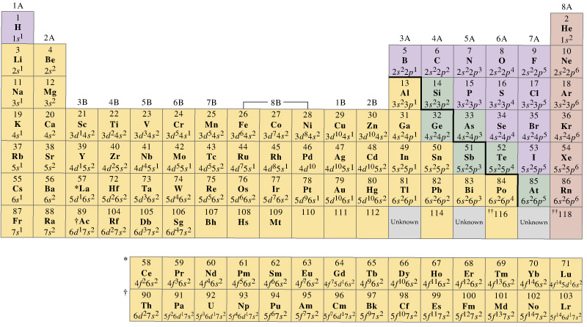
Periodic Table – Chemical trends
Periodicity is the recurrence of similar phenomena at regular interval.
Periodicity in chemical properties is the basis of the periodic table arrangement.
Periodicity of electron configuration:
Affects attraction of atom for its valence electrons
Affects attraction of valence electrons for additional electrons
Determines chemical and physical properties of the elements

Slide 3
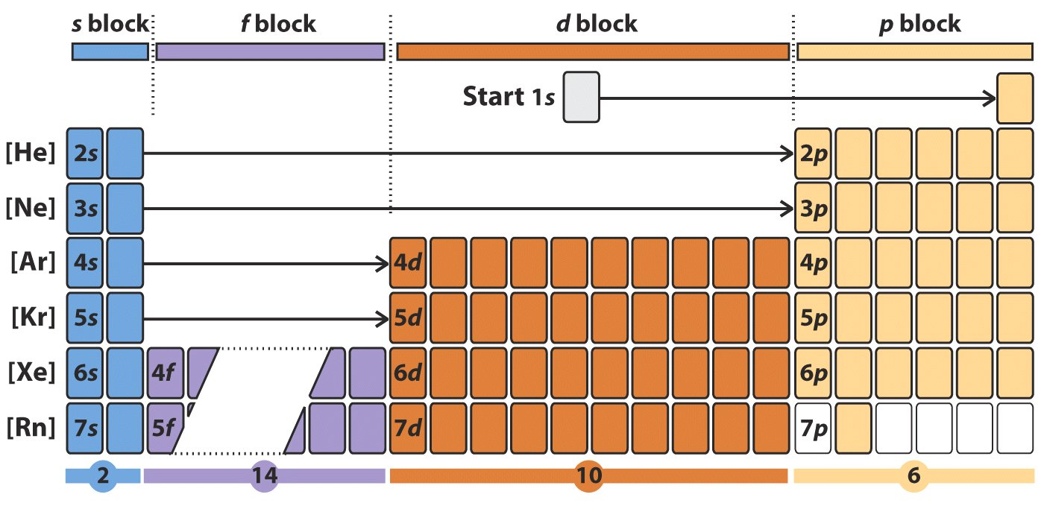
Modern Periodic Table
The elements in the periodic table are divided into blocks based on their valence electron orbitals. S-block, p-block, d-block, and f-block are the four blocks
The s-block and p-block together are usually considered main-group elements, the d-block corresponds to the transition metals, and the f-block encompasses nearly all of the lanthanides (like lanthanum) and the actinides (like actinium).

Slide 4
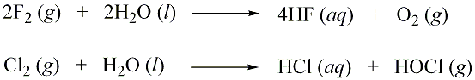
Recap
Electronegativity difference determines chemical products.
Example
Halides are expected to react similarly with water, but there are some important differences. Why?
Mnemonic for the most electronegative elements on the periodic table starting with the most electronegative on the top is FONCLBRISCH which stands for fluorine, oxygen, nitrogen, chlorine, bromine, iodine, sulfur, carbon, and hydrogen.

Slide 5
Questions
1) The elements in which the last electron enters one of the 5f orbitals (5f–block elements) are called
Ans: Actinides or actinons or actinoids
2) The d-block elements are called
Ans: The transition elements

Slide 6
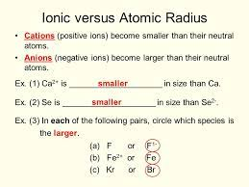

Slide 7
Chemical Reactions and Stoichiometry

Slide 8
Outline
Writing and balancing Chemical Equation
Classifying Chemical Reactions
Precipitation Reactions
Combustion reactions
Acid-base Reactions
Decomposition Reactions (non redox)
Oxidation-Reduction Reaction
Reaction Stoichiometry
Reaction Yields
Quantitative Chemical Analysis

Slide 9
Chemical Equations and Stoichiometry
A chemical equation is the symbolic representation of a chemical reaction in the form of symbols and formulae, wherein the reactant entities are given on the left-hand side and the product entities on the right.
a recipe for a reaction so it displays all the ingredients or terms of a chemical reaction
Stoichiometry is a section of chemistry that involves using relationships between reactants and/or products in a chemical reaction to determine desired quantitative data
The typical format of a chemical equation:
2Na_{(s)}+ 2HCl_{(aq)} → 2NaCl_{(aq)} + H_{2(g)}

Slide 10
Chemical Equations and Stoichiometry

Slide 11
Atomic mass and Atomic Weight
Atomic mass is the mass of a single atom or isotope whereas atomic weight represents the average weight of an element with respect to all its isotopes and their relative abundances.
Atomic mass is independent of the atomic masses of isotopes. Atomic weight is dependent upon the atomic mass of isotopes and their abundance.

Slide 12
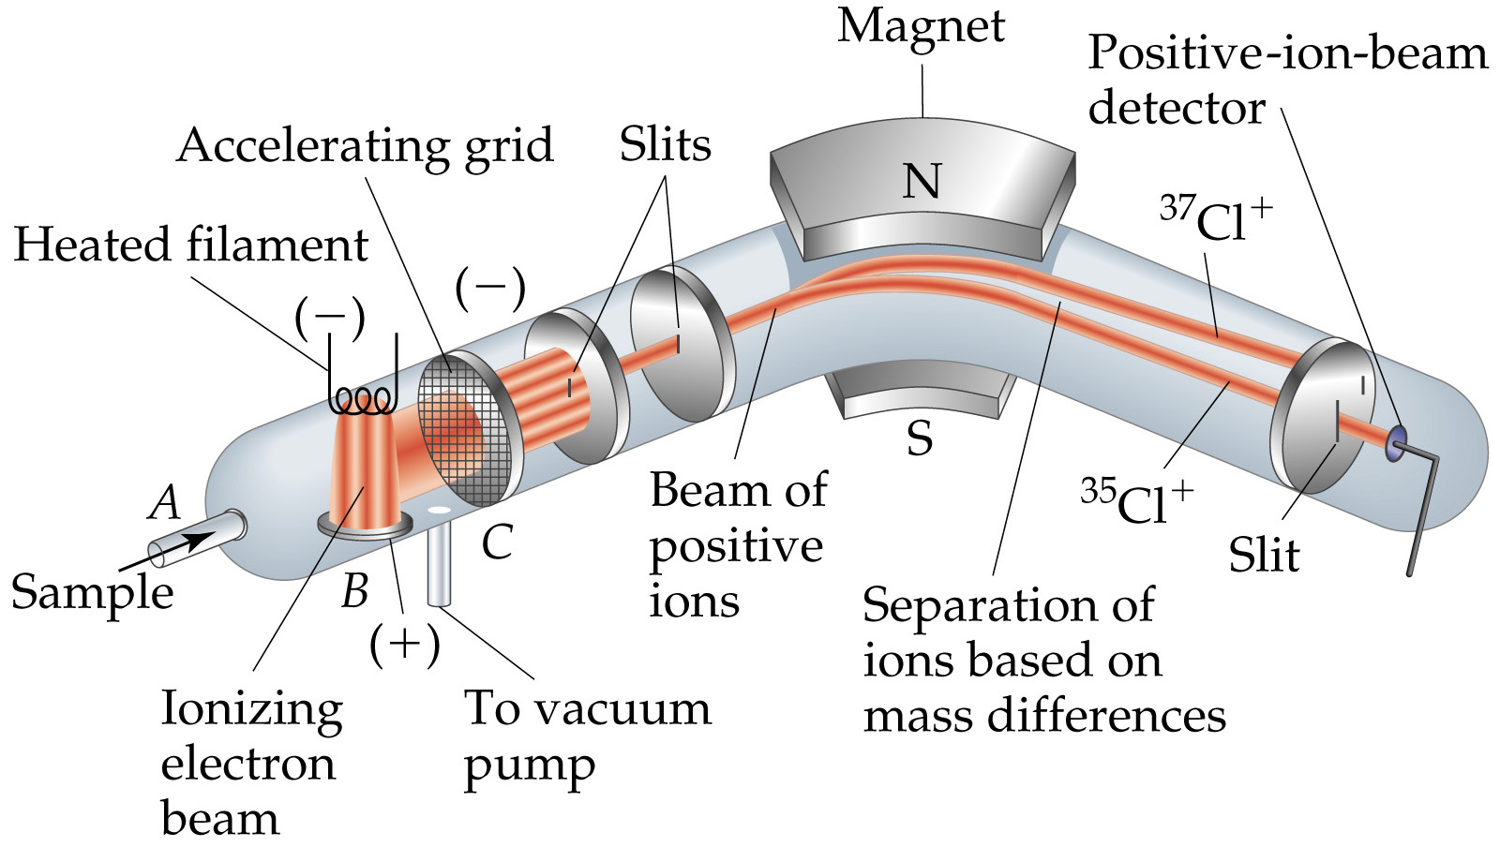
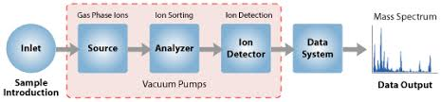
Mass Measurements
Mass Spectrophotometer

Slide 13
Chemical Equations and Stoichiometry
Five basic parts of a spectrometer
high vacuum system;
sample handling system, through which the sample to be investigated can be introduced;
an ion source, in which a beam of charged particles characteristic of the sample can be produced;
an analyzer, in which the beam can be separated into its components; and
detector or receiver by means of which the separated ion beams can be observed or collected.

Slide 14
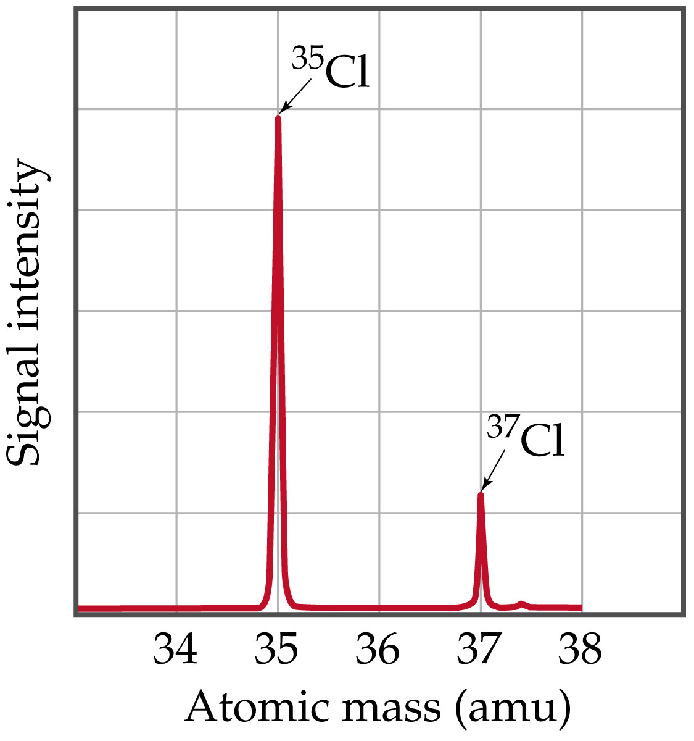

Slide 15
Avogadro’s number, number of units in one mole of any substance (defined as its molecular weight in grams) or the specific number of molecules in one gram-mole of a substance equal to 6.02214076 × 10²³.
The units may be electrons, atoms, ions, or molecules, depending on the nature of the substance and the character of the reaction (if any).
This quantity can be called Avogadro’s number, or the Avogadro constant. For example, the molecular weight of oxygen is 32.00, so that one gram-mole of oxygen has a mass of 32.00 grams and contains 6.02214076 × 10²³ molecules.
The volume occupied by one gram-mole of gas is about 22.4 litres (0.791 cubic foot) at standard temperature and pressure (0 °C, 1 atmosphere) and is the same for all gases, according to Avogadro’s law.

Slide 16
Atomic Weights
Average Atomic Masses
Relative atomic mass: average masses of isotopes:
Naturally occurring C: 98.892 % ¹²C + 1.108 % ¹³C.
Average mass of C:
(0.98892)(12 amu) + (0.01108)(13.00335) = 12.011 amu.
Atomic weight (AW) is also known as average atomic mass (atomic weight).
Atomic weights are listed on the periodic table.
But …1 amu = 1.66054 x 10⁻²⁴ g , still very small, how do we
Measure Chemicals with our 3 decimal place balances ? !!!
Mole Concept with Balanced Equation

Slide 17
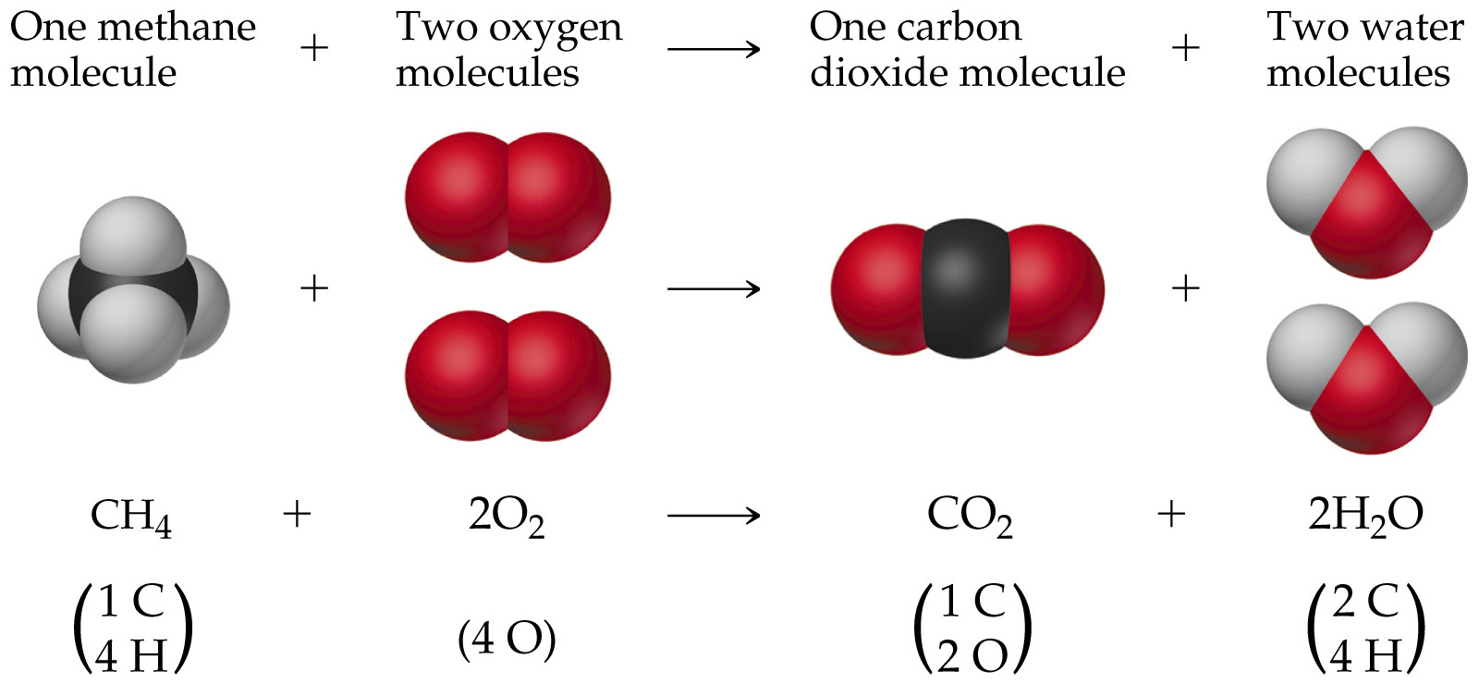
Combustion Reaction: Methane and Oxygen
O

Slide 18
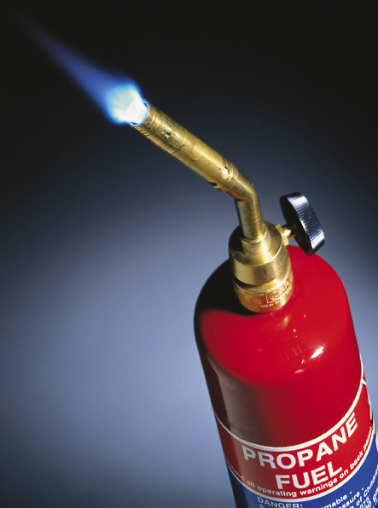
Some Simple Patterns of Chemical Reactivity
Combustion in Air
Combustion is the burning of a substance in oxygen from air:
C₃H₈(g) + 5O₂(g) → 3CO₂(g) + 4H₂O()

Slide 19
The Mole Concept
A mole: is a convenient measure of chemical quantities. It is the amount of substance containing Avogadro’s number of formula units.
1 mole of something = 6.0221367 × 10²³ of that thing. i.e. I mole of a substance = 6.0221367 × 10²³ atoms of that substance.
Experimentally, 1 mole of ¹²C has a mass of 12 g.
Molar Mass :
Molar mass: mass in grams of 1 mole of substance (units g/mol, g mol⁻¹).
Mass of 1 mole of ¹²C = 12 g.

Slide 20
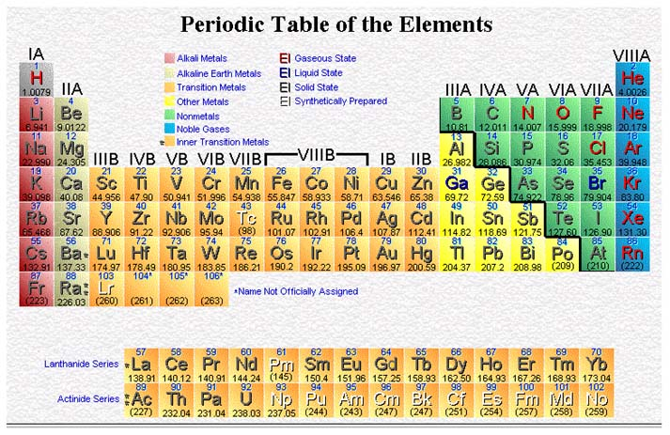
Molar Mass (weight in g/mol)
Molar Gas Volume at STP 22.4 dm³
Mole
Formula Units
6.02 X 10²³ units (Avogadro’s Number)

Slide 21
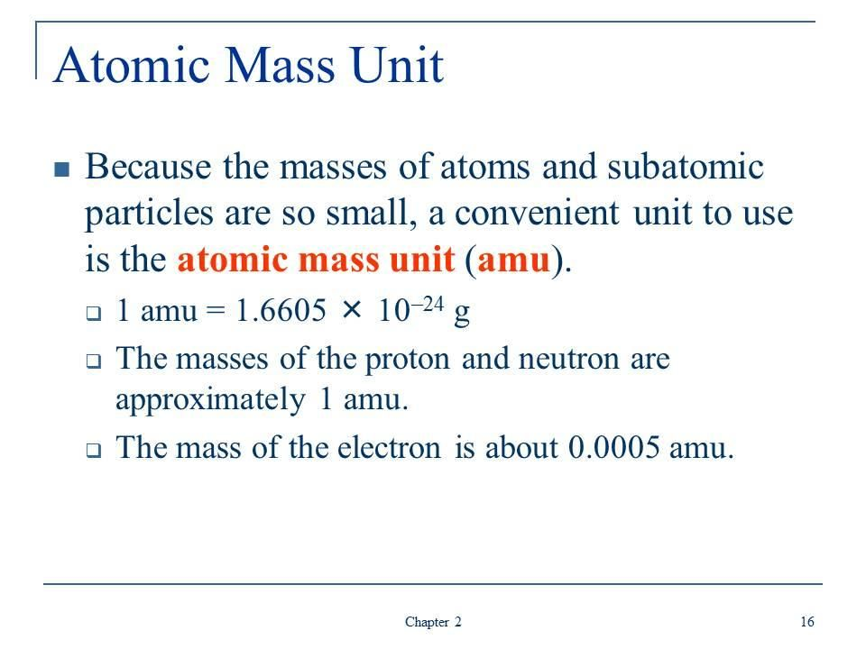

Slide 22
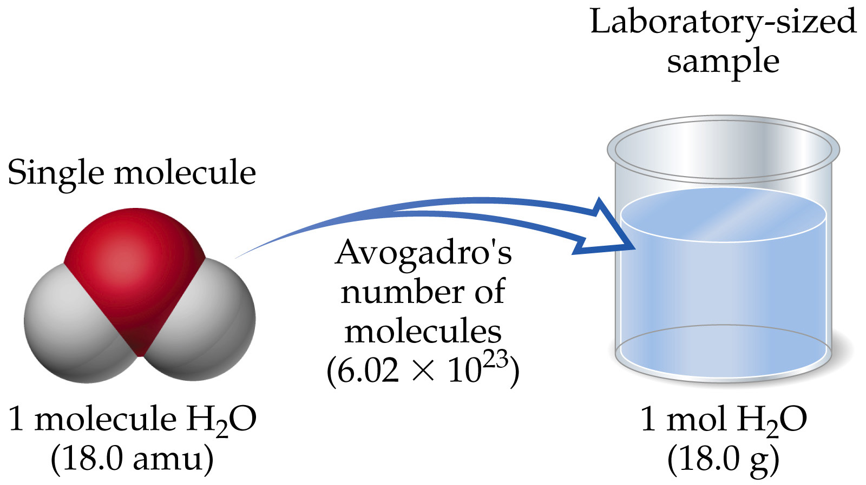
The Mole Concept
1 amu = 1.66054 x 10⁻²⁴ g
1 g = 6.02214 x 10²³ amu

Slide 23
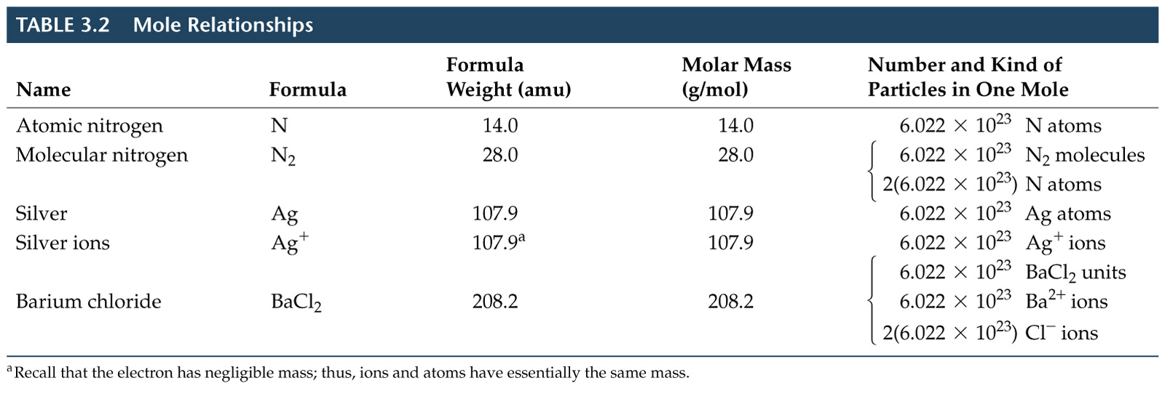
The Mole Concept

Slide 24
The Mole Concept
Acronym | Meaning | Units | Conversion Factors
AW | Atomic Weight | g mol⁻¹ | g atoms = mol atoms
MW | Molecular Weight | g mol⁻¹ | g molecules = mol molecules
L | Avogadro’s # (6.022x10²³ mol⁻¹) | (#) mol⁻¹ | # atoms/molecules = mol atoms/molecules
Formula |  |  | (mol) ratios of atoms in molecule
Balanced Equation |  |  | mol ratios of species in reaction

Slide 25
IUPAC CONVENTIONS & S.I UNITS
QUANTITY | SYMBOL | UNITS
Mass | m | g or Kg
Molar Mass | Mm | g mol⁻¹
Volume | V | cm³ or dm³
Molar Volume | Vm | dm³ mol⁻¹
Number of moles | n | mol
Molar Concentration | M | M or mol dm⁻³
Mass Concentration | C | g dm⁻³
Avogadro’s constant | L | mol⁻¹
H₂SO₄ (aq) | 2 H⁺ (aq) + | SO₄²⁻ (aq)
1 mole Mole ratio: 1 | 2 mole 2 | 1 mole 1

Slide 26
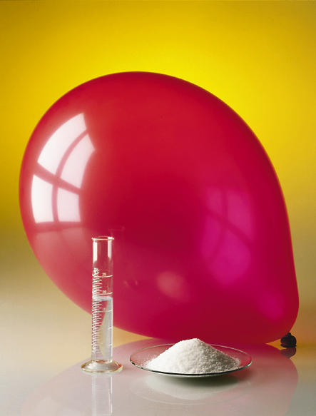
The Mole Concept
This photograph shows one mole of solid (NaCl), liquid (H₂O), and gas (N₂).
2 C₄H₁₀(g) + 13 O₂(g) → 8 CO₂(g) + 10 H₂O(l)
MW(g/mol): 58.12 32.00 44.01 18.02
Mole ratio: 2 : 13 : 8 : 10
Reacting Masses: 116.24 416 352.08 180.2
Number of moles, n = Reacting mass/Molar mass
Molarity (Molar Concentration), M = no of moles/volume of solution in dm³
Mass Concentration (Conc. In g/dm³) = Molarity X Molar mass
CyberChem: Mole

Slide 27
Formula Weights
Percentage Composition from Formulas
Percent composition is the atomic weight for each element divided by the formula weight of the compound multiplied by 100:
What is the total mass (amu) and percentage composition of carbon in each of the following molecules?
(a) CH₄ (b) CHCl₃ (c) C₁₂H₁₀O₆ (d) CH₃CH₂CH₂CH₂CH₃

Slide 28
Empirical Formula and Molecular Formula
% → relative mass → relative moles → simplest atom ratio → simplest integer ratio
Example 1: (a) Hydrazine contains 87.50% Nitrogen and 12.50% Hydrogen. What is its simplest formula? (b) If its molecular weight is 32.0 g, what is its molecular formula?
Example 2: Find the empirical formula for a compound with the following composition:
Na = 34.6% P = 23.3% O = 42.1%
NH₂, N₂H₄
Ans: Na₄P₂O₇
Example 3:An organic compound contains 72% carbon, 12% hydrogen and 16% oxygen by mass. The empirical formula of the compound is
A). C₈H₂₂O₃ B). C₆H₁₀O₃ C). C₁₂H₁₂O D). C₆H₁₂O E). C₃H₆O

Slide 29
STEPS FOR CALCULATING EMPERICAL AND MOLECULAR FORMULA
Percent | Nitrogen | Hydrogen
Relative Mass (relative to 100 grams) | 87.50% | 12.50%
Relative Moles (divide by respective AW) | 87.5/14 | 12.5/1
Simplest Atom/Mole Ratio (divide by smallest mole) | 6.25/6.25 | 12.50/6.25
Simplest Integer Ratio | 1 | 2
(NH₂)n = 32 | 16n = 32 | n = 2, i.e Molecular Formula is N₂H₄

Slide 30
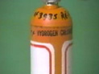
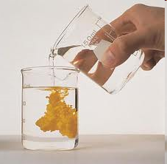
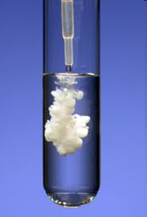
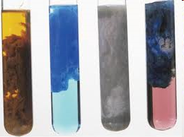
Precipitation Reactions
At room temperature and pressure, sodium is dissolved in water to give sodium hydroxide and hydrogen.
When two solutions are mixed and a solid is formed, the solid is called a precipitate.

Slide 31
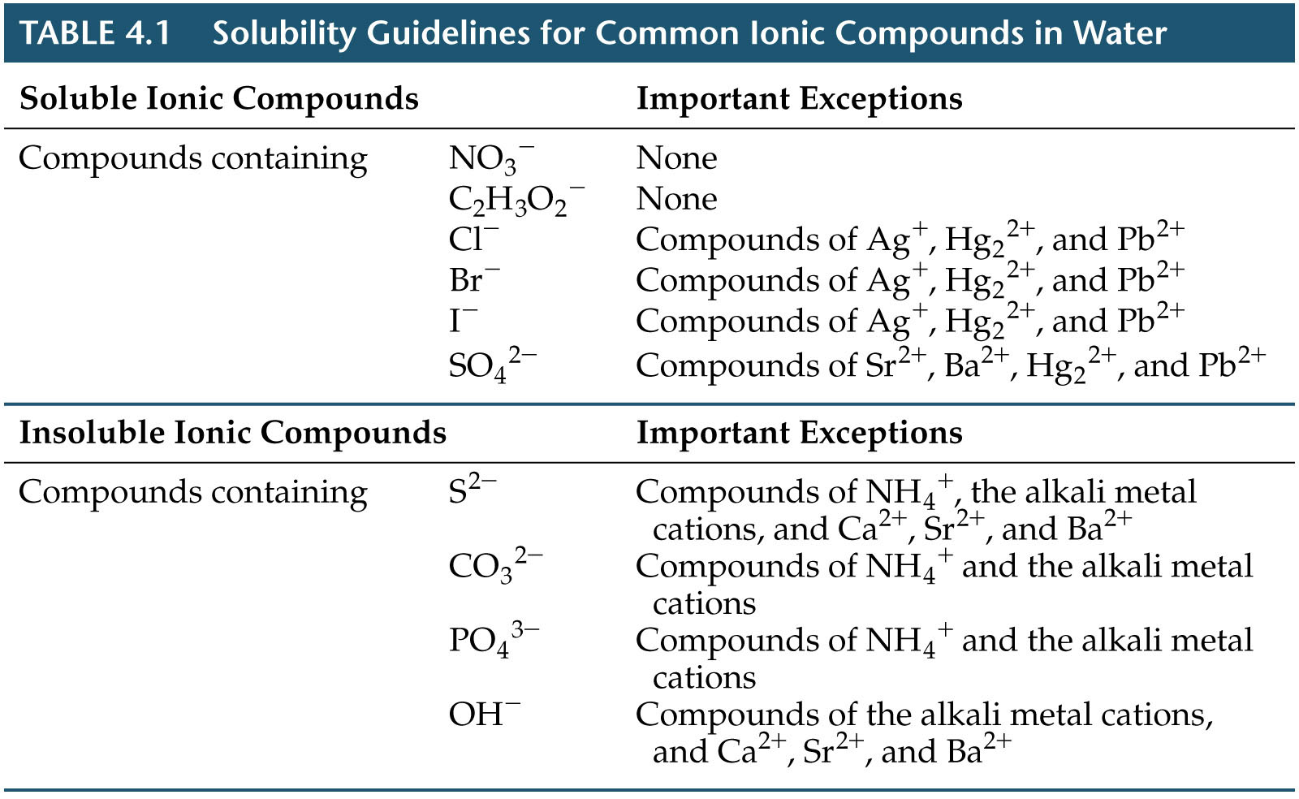
Precipitation Reactions

Slide 32
Precipitation Reactions
Ionic Equations
Ionic equation: used to highlight reaction between ions.
Molecular equation: all species listed as molecules:
HCl(aq) + NaOH(aq) → H₂O(l) + NaCl(aq)
Complete ionic equation: lists all ions:
H⁺(aq) + Cl⁻(aq) + Na⁺(aq) + OH⁻(aq) → H₂O(l) + Na⁺(aq) + Cl⁻(aq)
Net ionic equation: lists only unique ions:
H⁺(aq) + OH⁻(aq) → H₂O(l)

Slide 33

Concentrations of Solutions – Molar and Mass Conc.
Solution = solute dissolved in solvent.
Solute: present in smallest amount.
Water as solvent = aqueous solutions.
Change concentration by using different amounts of solute and solvent.
Molarity: Moles of solute per liter or per dm³ of solution.
If we know: molarity and liters of solution, we can calculate moles (and mass) of solute.

Slide 34
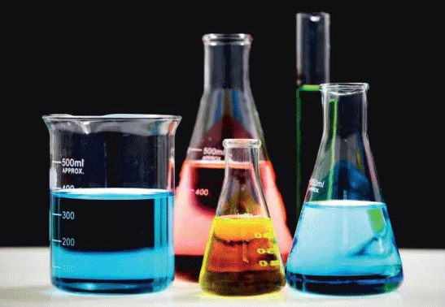
Concentrations of Solutions and dilution principle
Since the number of moles are the same in dilute and concentrated solutions, we can derive the dilution formula.
So:
M_{dilute}V_{dilute} = moles = M_{concentrated}V_{concentrated}

Slide 35
Writing & Balancing Chemical Equations (Calculations)
Rules for writing and balancing equations:
Formulas of substances in the equation MUST BE CORRECTLY WRITTEN and not be altered during balancing.
Use SMALLEST INTEGER coefficients to balance equations; coefficient “1” need not be indicated;
Helpful steps in balancing equations:
Begin with the compound that contains the most types of atoms.
Balance atoms that appear only once on each side of the arrow.
Then balance atoms that appear more than once on either side.
Balance free elements last.
Finally, check that smallest whole number coefficients are used; if a fraction occurs after all atoms are balanced, multiply the entire equation by a factor that would remove the fraction

Slide 36
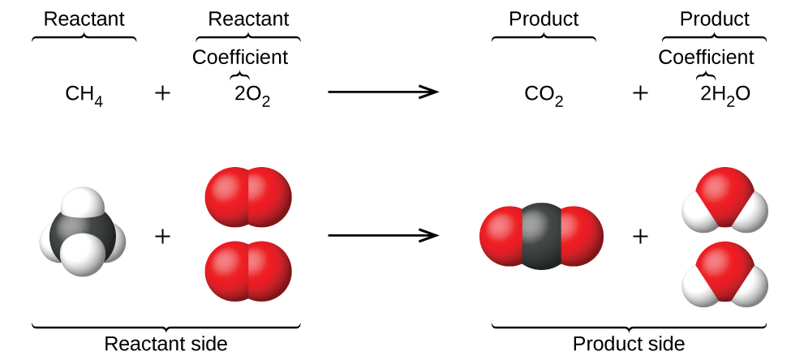
The reaction between methane and oxygen gas that yields carbon dioxide and water (bottom) is given in the form of a chemical equation shown below (top):

Slide 37
Chemical Equation #1
Describe the reaction:
“Magnesium reacts with oxygen gas to form solid magnesium oxide.”
Chemical identity of reactants and products (in correct symbols and formulas):
Reactants = Mg(s) and O₂(g);
Product = MgO(s)
Chemical equation: Mg(s) + O₂(g) → MgO(s)
Balanced equation: 2Mg(s) + O₂(g) → 2MgO(s)

Slide 38
Chemical Equation #2
Describe the reaction:
Lithium reacts with nitrogen gas to form solid lithium nitride:
Chemical identity (in correct symbols and formulas):
Reactants = Li(s) and N₂(g);
Product = Li₃N(s)
Chemical equation: Li(s) + N₂(g) → Li₃N(s)
Balanced equation: 6Li(s) + N₂(g) → 2 Li₃N(s)

Slide 39
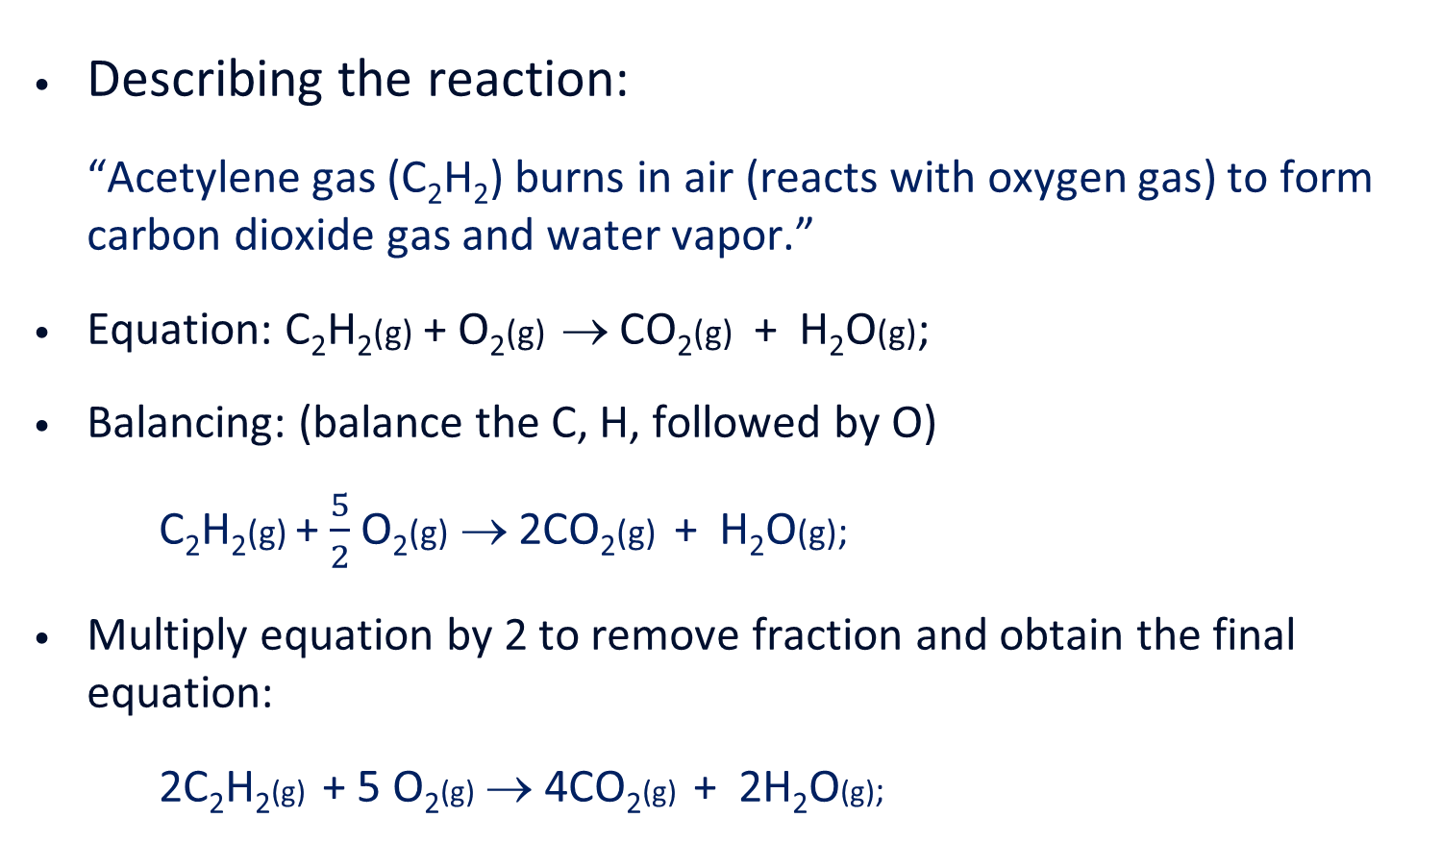
Chemical Equation #3
Describing the reaction:
“Acetylene gas (C₂H₂) burns in air (reacts with oxygen gas) to form carbon dioxide gas and water vapor.”
Equation: C₂H₂(g) + O₂(g) →CO₂(g) + H₂O(g);
Balancing: (balance the C, H, followed by O)
C₂H₂(g)+ $\frac{5}{2}$ O₂(g)→ 2CO₂(g)+ H₂O(g);
Multiply equation by 2 to remove fraction and obtain the final equation:
2C₂H₂(g)+ 5 O₂(g)→ 4CO₂(g)+ 2H₂O(g);

Slide 40
Chemical Equation #4
Describing the reaction:
“Ammonia (NH₃) reacts with oxygen gas to produce nitrogen monoxide gas and water vapor.”
The equation: NH₃(g) + O₂(g) → NO(g) + H₂O(g);
Balancing the equation:
2NH₃(g) + ⁵/₂ O₂(g) → 2NO(g) + 3H₂O(g)
Multiply equation by 2 to remove fraction and yield final equation:
4NH₃(g) + 5 O₂(g) → 4NO(g) + 6H₂O(g)

Slide 41
Stoichiometry (Calculations)
Stoichiometry – the quantitative relationship between reactants and products, as well as between one reactant to another in a chemical reaction.
Start by understanding a balanced equation:
Example: C₃H₈(g) + 5 O₂(g) → 3CO₂(g) + 4H₂O(g);
At molecular level this equation indicates that:
one C₃H₈ molecule reacts with five O₂ molecules to produce three CO₂ molecules and four H₂O molecules;
At macroscopic level
1 mole of C₃H₈ reacts with 5 moles of O₂ to produce 3 moles of CO₂ and 4 moles of H₂O.

Slide 42
Interpreting Balanced Equation
A balanced equation provides the mole-to-mole relationship between reactants and products, as well as between one reactant to another.
An Example of a Stoichiometric calculation.
Consider the following equation and the accompanying question:
C₃H₈(g) + 5 O₂(g) → 3CO₂(g) + 4H₂O(g)
If 5.15 moles of C₃H₈ were completely reacted, how many moles of CO₂ and H₂O, respectively, will be formed? How many moles of O₂ will be consumed?

Slide 43
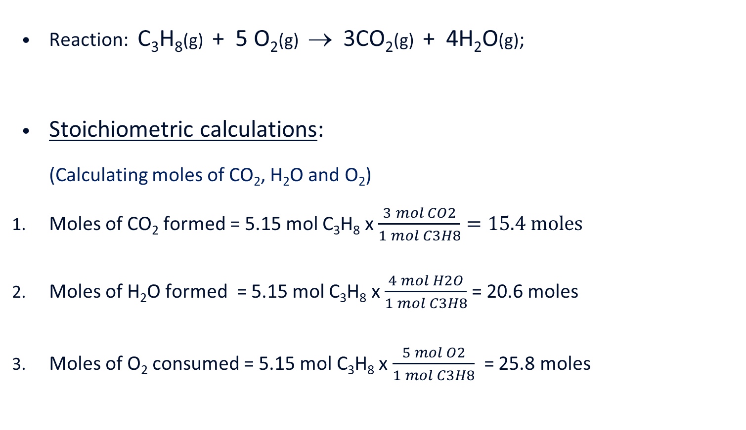
Stoichiometric Calculation #1
Reaction: C₃H₈(g)+ 5 O₂(g)→ 3CO₂(g)+ 4H₂O(g);
Stoichiometric calculations:
(Calculating moles of CO₂, H₂O and O₂)
Moles of CO₂ formed = 5.15 mol C₃H₈ x $\frac{3 mol CO2}{1 mol C3H8}=15.4 moles$
Moles of H₂O formed = 5.15 mol C₃H₈ x $\frac{4 mol H2O}{1 mol C3H8}$ = 20.6 moles
Moles of O₂ consumed = 5.15 mol C₃H₈ x $\frac{5 mol O2}{1 mol C3H8}$ = 25.8 moles

Slide 44
Stoichiometric Calculation #2
Consider the following reaction:
2C₈H₁₈(l) + 25 O₂(g) → 16CO₂(g) + 18H₂O(g)
If 4.386 moles of octane (C₈H₁₈) were completely burned, how many moles of CO₂ and H₂O, respectively, will be produced? How many moles of O₂ will be reacted? Find the masses of CO₂ and H₂O that was produced.

Slide 45
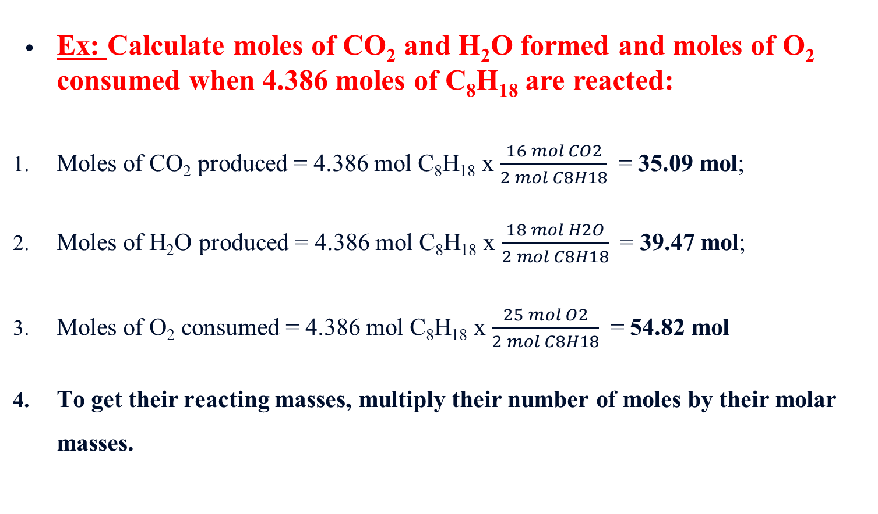
Stoichiometric Calculation #2
Ex: Calculate moles of CO₂ and H₂O formed and moles of O₂ consumed when 4.386 moles of C₈H₁₈ are reacted:
Moles of CO₂ produced = 4.386 mol C₈H₁₈ x $\frac{16 mol CO2}{2 mol C8H18}$ = 35.09 mol;
Moles of H₂O produced = 4.386 mol C₈H₁₈ x $\frac{18 mol H2O}{2 mol C8H18}$ = 39.47 mol;
Moles of O₂ consumed = 4.386 mol C₈H₁₈ x $\frac{25 mol O2}{2 mol C8H18}$ = 54.82 mol
To get their reacting masses, multiply their number of moles by their molar masses.

Slide 46
Stoichiometric Calculation #3
Mass-to-mole-to-mole-to-mass relationship:
If the mass of reactant is given, instead of mole, this must be converted to mole, because the balanced equation only provides a mole-to-mole relationship.
Example-1: In the following reaction, if 653.0 g of octane, C₈H₁₈, are completely combusted, how many grams of CO₂ are formed?
2C₈H₁₈(l) + 25 O₂(g) → 16CO₂(g) + 18H₂O(g)
Calculation process: (1) convert mass of C₈H₁₈ to moles; (2) calculate moles of CO₂ using stoichiometric relationship of C₈H₁₈ to CO₂ given in the balanced equation; (3) convert moles of CO₂ to grams.

Slide 47
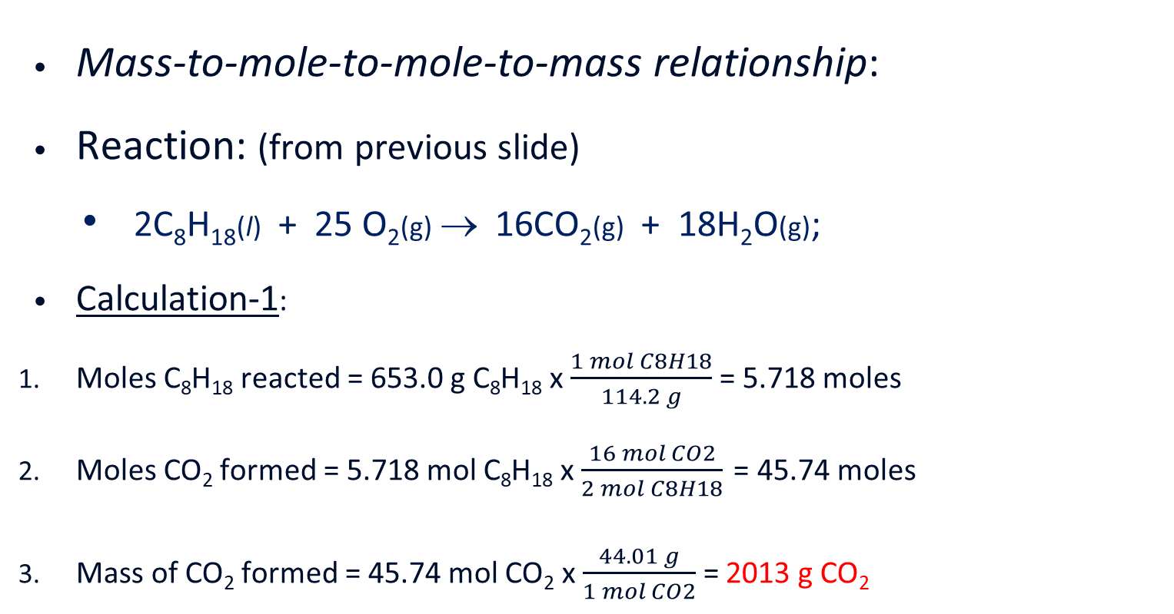
Stoichiometric Calculation #3
Mass-to-mole-to-mole-to-mass relationship:
Reaction: (from previous slide)
2C₈H₁₈(l) + 25 O₂(g)→ 16CO₂(g) + 18H₂O(g);
Calculation-1:
Moles C₈H₁₈ reacted = 653.0 g C₈H₁₈ x $\frac{1 mol C8H18}{114.2 g}$ = 5.718 moles
Moles CO₂ formed = 5.718 mol C₈H₁₈ x $\frac{16 mol CO2}{2 mol C8H18}$= 45.74 moles
Mass of CO₂ formed = 45.74 mol CO₂ x $\frac{44.01 g}{1 mol CO2}$ = 2013 g CO₂

Slide 48
Stoichiometric Calculation #4
Mass-to-mole to mole-to-mass relationship:
Example-2: In the following reaction, if 653.0 g of octane, C₈H₁₈, are completely combusted, how many grams of H₂O are produced?
2C₈H₁₈(l) + 25 O₂(g) → 16CO₂(g) + 18H₂O(g)
Calculation process: (1) convert grams of C₈H₁₈ to mol; (2) calculate moles of H₂O using stoichiometric relationship of C₈H₁₈ to H₂O H₂O from balanced equation; (3) convert moles of H₂O to grams.

Slide 49
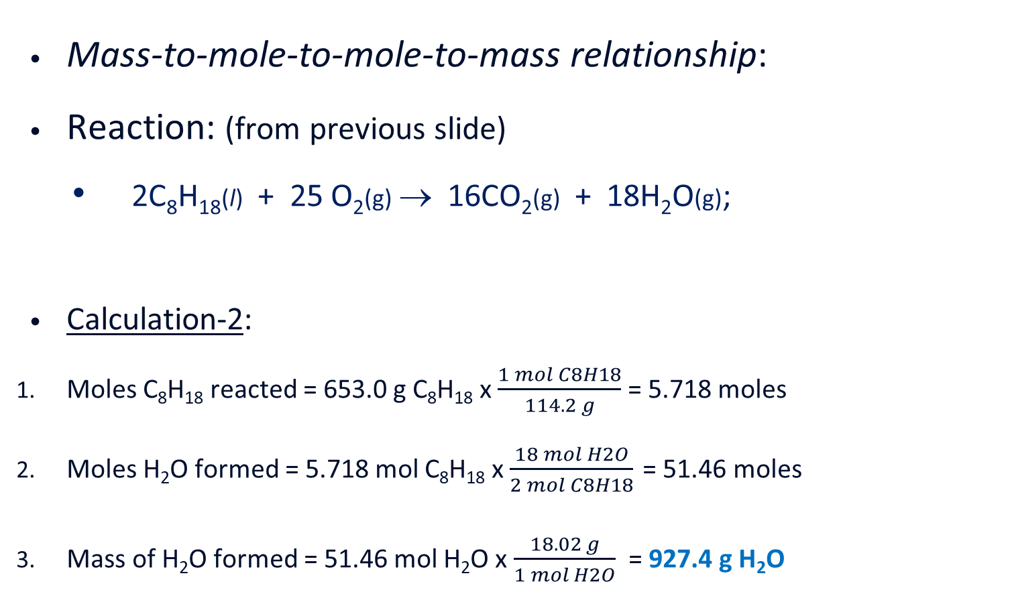
Stoichiometric Calculation #4
Mass-to-mole-to-mole-to-mass relationship:
Reaction: (from previous slide)
2C₈H₁₈(l) + 25 O₂(g)→ 16CO₂(g) + 18H₂O(g);
Calculation-2:
Moles C₈H₁₈ reacted = 653.0 g C₈H₁₈ x $\frac{1 mol C8H18}{114.2 g}$ = 5.718 moles
Moles H₂O formed = 5.718 mol C₈H₁₈ x $\frac{18 mol H2O}{2 mol C8H18}$= 51.46 moles
Mass of H₂O formed = 51.46 mol H₂O x $\frac{18.02 g}{1 mol H2O}$ = 927.4 g H₂O

Slide 50
Stoichiometric Calculation #5
Mass-to-mole-to-mole-to-mass relationship:
Example-3: In the following reaction, if 653.0 g of octane, C₈H₁₈, are completely combusted, how many grams of O₂ are consumed?
2C₈H₁₈(l) + 25 O₂(g) → 16CO₂(g) + 18H₂O(g)
Calculation process: (1) convert grams of C₈H₁₈ to mol; (2) calculate moles of O₂ using the stoichiometric relationship of C₈H₁₈ to O₂ given in balanced equation; (3) convert moles of O₂ to grams.

Slide 51
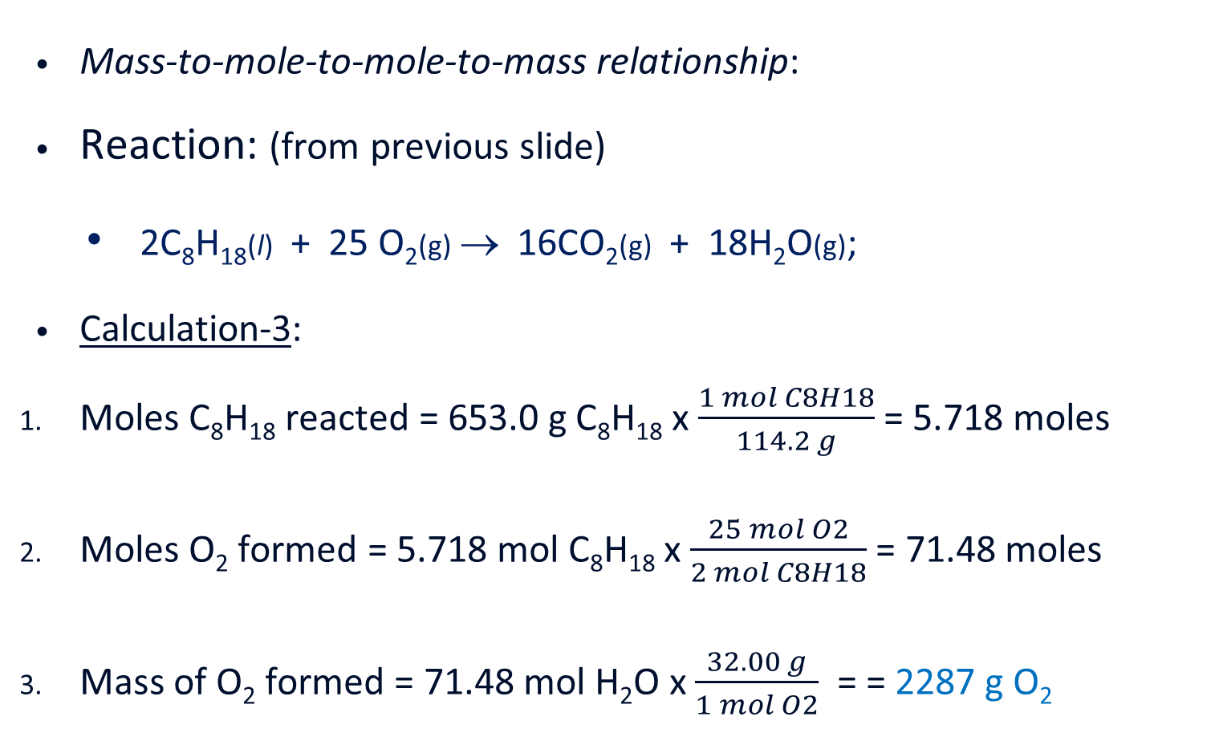
Stoichiometric Calculation #5
Mass-to-mole-to-mole-to-mass relationship:
Reaction: (from previous slide)
2C₈H₁₈(l) + 25 O₂(g)→ 16CO₂(g) + 18H₂O(g);
Calculation-3:
Moles C₈H₁₈ reacted = 653.0 g C₈H₁₈ x $\frac{1 mol C8H18}{114.2 g}$ = 5.718 moles
Moles O₂ formed = 5.718 mol C₈H₁₈ x $\frac{25 mol O2}{2 mol C8H18}$ = 71.48 moles
Mass of O₂ formed = 71.48 mol H₂O x $\frac{32.00 g}{1 mol O2}$ = = 2287 g O₂

Slide 52
Stoichiometry Involving Limiting Reactant
Limiting reactant
One that got completely consumed in a chemical reaction before the other reactant(s).
The product yields depend on the amount of the limiting reactant.

Slide 53
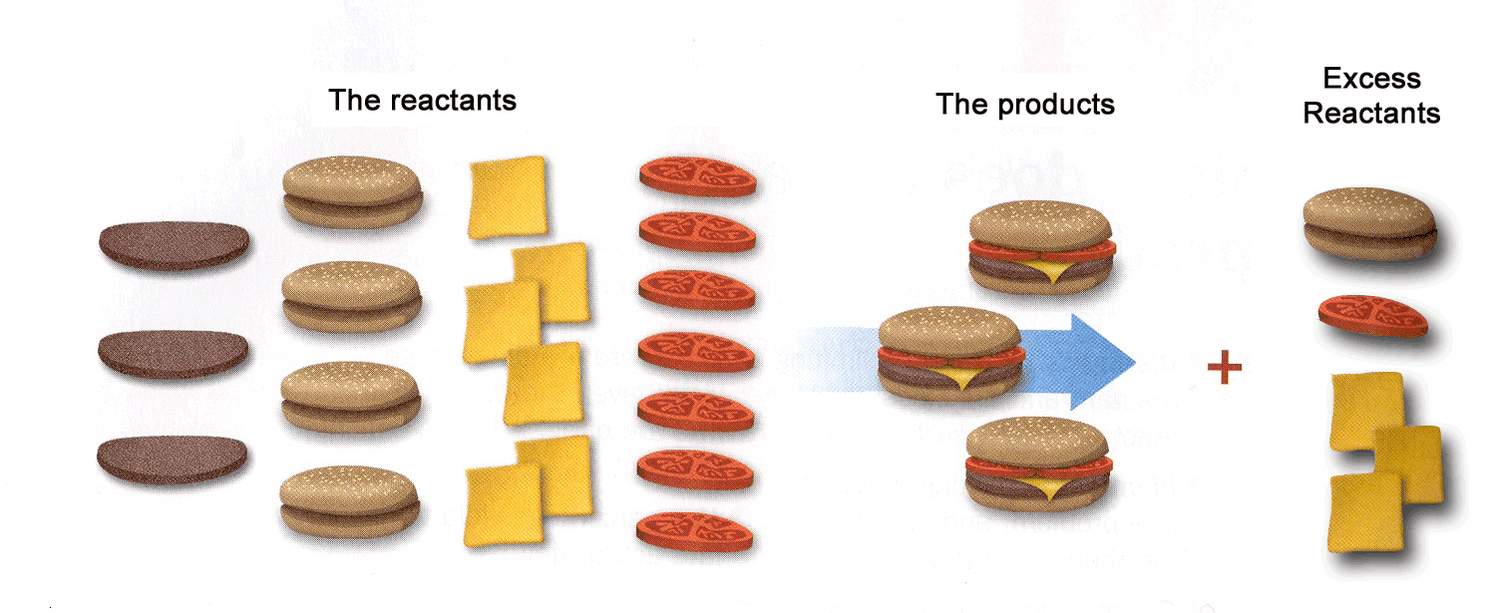
Making cheese burgers to illustrate the concepts of limiting and excess reactants. (Ingredient: 1 hamburger bun + 1 hamburger patty + 1 slice of cheese + 2 tomato slices = 1 cheese burger)

Slide 54
The Concept of Limiting Reactant
For example, in the synthesis of water according to the following equation:
2H₂(g) + O₂(g) → 2H₂O(l),
The equation indicates that 2 H₂ molecules react with 1 O₂ molecule to produce 2 H₂O molecules.
If a reaction is carried out with 10 molecules of H₂ and 7 molecules of O₂, O₂ will be in excess, since 10 H₂ will require only 5O₂ molecules.
H₂ will be the limiting reactant; the reaction will produce 10 molecules of H₂O.

Slide 55
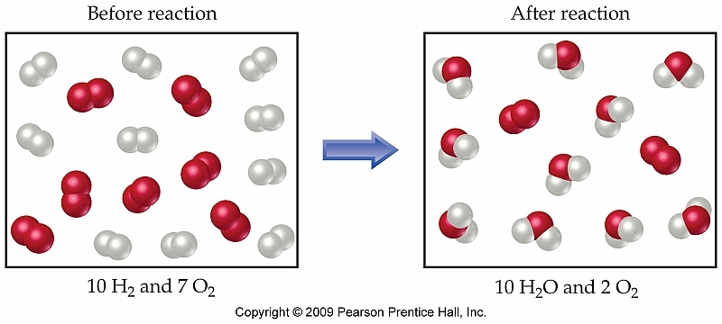
Limiting and Excess Reactants in the Synthesis of H₂O: 2H₂ + O₂ → 2H₂O

Slide 56
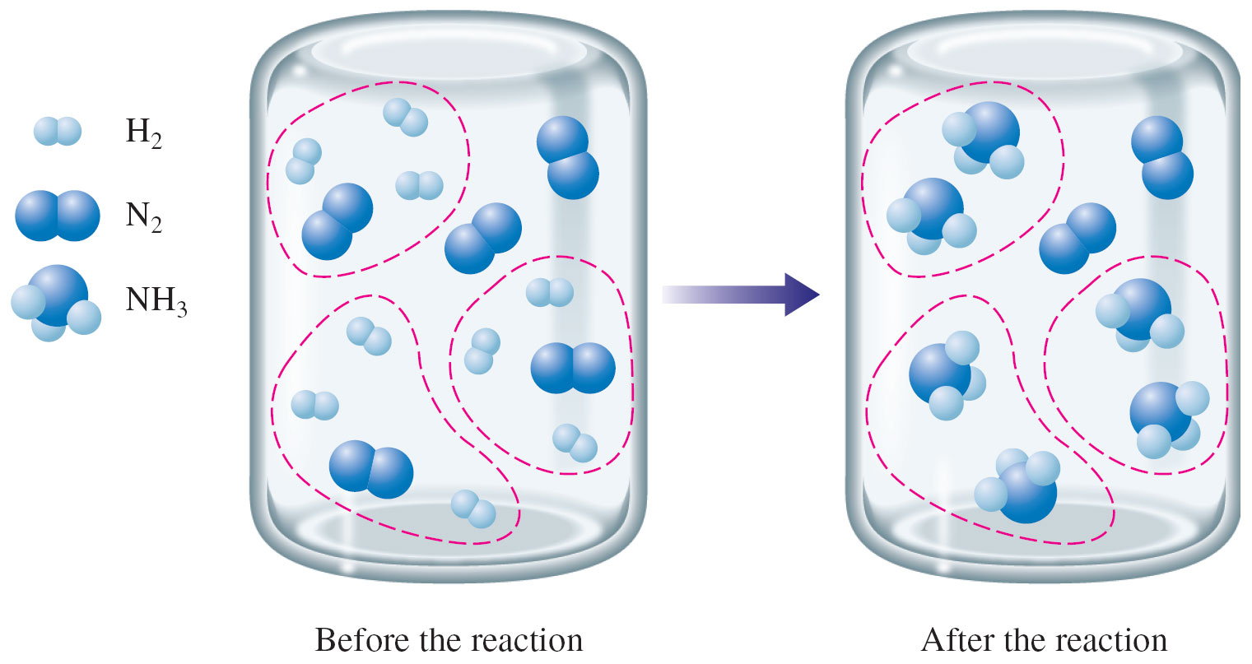
Synthesis of NH₃

Slide 57
Stoichiometry Calculations involving limiting reactant
Exercise-#1:
Ammonia is produced by the reaction of N₂ with H₂ according to the following equation:
N₂(g) + 3H₂(g) → 2NH₃(g)
If 5.0 moles of N₂ are reacted with 12.0 moles of H₂, which is the limiting reactant?
How many moles of NH₃ are formed?
How many moles of the excess reactant remains after the reaction?
(Answer: (a) H₂; (b) 8.0 moles; (c) 1.0 mol)
Clue
1st: identify the limiting reactant (LR)
by comparing the mole ratio of the reactants in the equation with the given mole ratio
2nd: use the LR as reference for other calculations

Slide 58
Limiting Reactants and Reaction Yields
Exercise-#2:
Ammonia is produced in the following reaction:
N₂(g) + 3H₂(g) → 2NH₃(g)
If 118 g of nitrogen gas is reacted with 31.5 g of hydrogen gas, which reactant will be completely consumed at the end of the reaction?
How many grams ammonia will be produced when the limiting reactant is completely reacted and the yield is 100%?
How many grams of the excess reactant will be unreacted?
Answer: (a) N₂; (b) 143 g NH₃; (c) 6.0 g of H₂

Slide 59
NOTE
The chemical formula for the chlorine molecule (chlorine gas or diatomic chlorine) is Cl₂, which means it is composed of two chemically bonded chlorine atoms.
The mass of one mole of chlorine gas is its molar mass, and can be determined by multiplying its subscript by the molar mass of chlorine (atomic weight on the periodic table in g/mol), which is 35.45 g/mol.
MMCl2=(2×35.45 g/mol Cl)=71 g/mol (rounded to two significant figures)

Slide 60
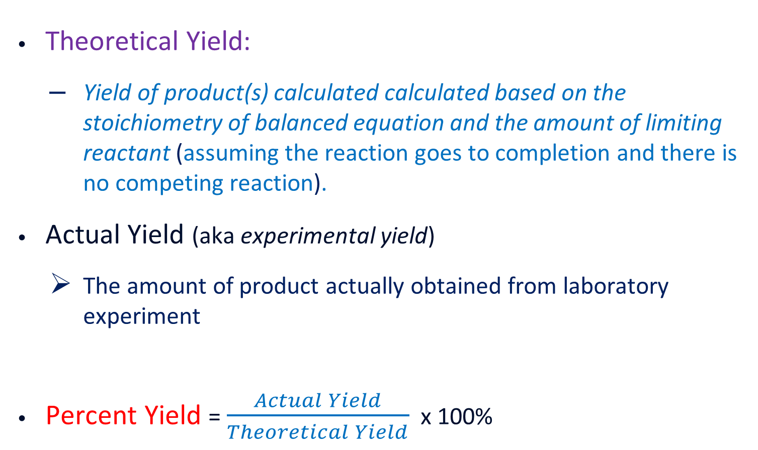
Theoretical, Actual and Percent Yields
Theoretical Yield:
Yield of product(s) calculated calculated based on the stoichiometry of balanced equation and the amount of limiting reactant (assuming the reaction goes to completion and there is no competing reaction).
Actual Yield (aka experimental yield)
The amount of product actually obtained from laboratory experiment
Percent Yield = $\frac{Actual Yield}{Theoretical Yield}$ x 100%

Slide 61
Limiting Reactant & Yields
Exercise-#3:
The production of ammonia is carried out according to the following equation:
N₂(g) + 3H₂(g) → 2NH₃(g)
In one reaction at 227ºC, the reactor is charged with 805.0 g of N₂ and 167.5 g of H₂.
Determine the limiting reactant.
What is the expected yield of ammonia?
If 831.3 g of NH₃ are actually produced, calculate the percentage yield.
(Answer: (a) H₂; (b) 943.3 g NH₃; (b) Percent yield = 88.13%)

Slide 62
Reactions in Aqueous Solution
Many reactions taking place in the environments and in our body occur in aqueous solution in which water is the solvent.

Slide 63
Water as a Universal Solvent
Water molecule is very polar and has a strong dipole property;
Water interacts strongly with ionic and polar molecules;
Strong interactions enable water to dissolve many substances – both ionic and nonionic;
The solubility of ionic compounds depends on the relative strength of ion-dipole interactions between the ions and water molecules;
Many ionic compounds dissolve in water because of the strong ion-dipole interactions;
Polar nonionic compounds, such as alcohol and sugar, dissolve in water due to strong dipole-dipole interactions and hydrogen bonding;

Slide 64
Dissolution of Ionic Compounds:
Ionic compounds dissociate into separate cations and anions when dissolved in water.

Slide 65
Particles present in Aqueous Solutions containing Ionic and Molecular Compounds
ELECTROLYTES

Slide 66
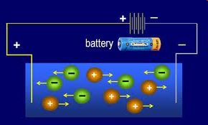
Free ions in solution conduct electric current; such substances are called Electrolytes which include substances such as ionic compounds and strong acids and bases
ELECTROLYTES

Slide 67
Electrolytes and Nonelectrolytes
Electrolytes – solutions capable of conducting electric current - contain ions that move freely;
Nonelectrolytes – solutions not capable of conducting electric current - contains neutral molecules only;
Strong electrolytes – ionic compounds, strong acids and strong bases; they dissociate completely when dissolved in water, producing a lot of free ions;
Weak electrolytes – weak acids or weak bases: they only ionize partially when dissolved in water; solutions contain mostly neutral molecules and very little free ions.

Slide 68
Quantitative Analysis – From Laboratory to the Class
Molarity: The molarity of a solution is defined as the number of moles of solute in one cubic decimeter (dm 3 ) or one litre (L) of solution.
Molarity = Moles of solute Volume of solution in 1 dm3 Thus, a solution is one molar with respect to a given solute if it contains one mole of that solute in one cubic decimeter (dm3 ) m of solution.
Molality: The molality of a solution is defined as the number of moles of solute in one kilogram (kg) of solution. Let us remind ourselves here of what a molal or indeed 1 molal is: The weight in grams of a substance Formula weight in grams of the substance
Normality (N): Normality is the number of gram — equivalent weight of solute in 1 dm3 of solution. This term is no longer in use but you will probably encounter it in some chemistry textbooks. Normality = Equivalent weight of solute Volume of solution in dm3
Important Terms

Slide 69
Excercises
1) Calculate the number of moles of calcium chloride, CaCl₂ that can be obtained from 25g of limestone, CaCO₃ in the presence of excess hydrogen chloride, HCl. (Ca=40, C=12, O=16, H=1, Cl=35.5)
2) What mass of lead(II)trioxonitrate (V), Pb(NO₃)₂, would be required to yield 9g of Lead(II)chloride, PbCl₂, on addition of excess sodium chloride solution, Nacl? (Pb=207, N=14, O=16, Na=23, Cl=35.5)
0.25 moles
10.7g
Solution
331g of Pb(NO₃)₂ yielded 278g of PbCl₂
xg of Pb(NO₃)₂ would yield 9g of PbCl₂ ie 331g Pb(NO₃)₂ = 278g of PbCl₂ xg of Pb(NO₃) = 9g of PbCl₂ x = 331g x 9g divided by 278g x= 10.7g therefore, 10.7g of Pb(NO3)2 would be required to yield 9g of PbCl2.

Slide 70
Excercises
3) Determine the mass of carbon (IV) oxide, CO₂, produced on burning 104g ethyne, C₂H₂ (C=12, O=16, H=1).
352g
4) If the industrial preparation of hydrogen trioxonitrate (V) acid, ammonia gas, NH3, is burned in oxygen O2, in the presence of a catalyst according to the following equation: 4NH₃(g) + 5O₂ 4NO(g) + 6H₂0(g)
If 260cm³ of NH₃ are burned completely, what volume of a) O₂ is used up? B) NO is produced.
a. 325cm³, b. 260cm³
5) 20cm³ of CO are mixed and sparked with 200cm³ of air containing 21% of O₂. If all the volumes are measured at s.t.p., calculate the total volume of the resulting gases.
210cm³

Slide 71
Quantitative Analysis
6) Calculate the mass of sodium hydroxide in 5.00 dm³ of a 0.125 mol dm⁻³ solution. [NaOH = 40 g mol⁻¹]
A) 0.0156 g B) 0.625 g C) 1.00 g D) 25.0 g
7) When 50cm³ of a saturated solution of sugar (molar mass 342.0g) at 40ºC was evaporated to dryness, 34.2g of dry solid was obtained. The solubility of sugar at 40ºC is
A. 10.0 moles dm⁻³ B. 7.0 moles dm⁻³ C. 3.5 moles dm⁻³
D. 2.0 moles dm⁻³

Slide 72
Quantitative Analysis
8) 200cm³ each of 0.1M solutions of lead (II) trioxonitrate (V) and hydrochloric acid were mixed. Assuming that lead (II) chloride is completely insoluble, calculate the mass of lead (II) chloride that will be precipitated. [Pb = 207, Cl= 35.5, N = 14, O = 16]
A. 2.78g B. 5.56g C. 8.34g D. 11.12g
Solution
The balanced equation of the reaction is: Pb(NO₃)_{2(aq)} + 2HCl_{(aq)} ---> PbCl_{2(s)} + 2HNO_{3(aq)}
From the balanced equation, 1 mole of Pb(NO₃)₂ gave 1 mole of PbCl₂
Using, molar concentration = no of moles/volume in dm³
no of moles = molar concentration x volume in dm³ where, molar concentration of Pb(NO₃)₂ = 0.1M volume of Pb(NO₃)₂ in dm³ = 0.2 dm³
therefore, no of moles of Pb(NO₃)₂ = 0.1M x 0.2 dm3 = 0.02 mol

Slide 73
Quantitative Analysis
continuation From the balanced equation of the reaction, 1mol of Pb(NO₃)₂ gave 1mol of PbCl₂, therefore 0.02mol of Pb(NO₃)₂ will give 0.02mol of PbCl₂.
But using, no of moles = mass/molar mass, mass = no of moles x molar mass
where, no of moles of PbCl₂ = 0.02mol molar mass of PbCl₂ = 207 + (2 * 35.5) = 278 g/mol therefore, mass of PbCl₂ = 0.02mol * 278g/mol = 5.56g therefore, mass of PbCl₂ that precipitated out is 5.56g (option B)

Slide 74
Quantitative Analysis
Calculate the volume of hydrogen chloride gas at s.t.p. that would yield 1.2 dm³ of 0.15 mol/dm³ aqueous hydrogen chloride solution (molar volume of all gases at s.t.p. = 22.4 dm³).
Calculate the volume of 0.25 mol/dm³ solution of tetraoxosulphate(VI) acid, H₂SO₄, that will contain a mass of 4.5g of the raw acid. (H= 1, S=32, O=16).
4.03 dm³
183.7 cm³

Slide 75
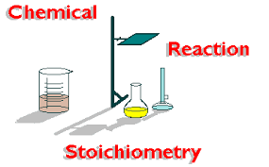
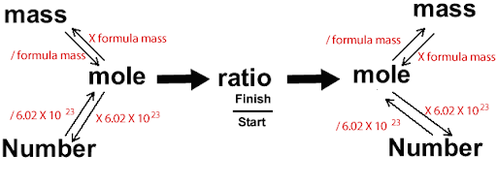
THANK
YOU
Notes:
A plumbob is heavy and used by carpenters to build walls straight. The word lead in latin is plumbum meaning heavy.

